Slide 1
Software Engineering
Week 06 Lecture 01

Slide 2
REQUIREMENT ANALYSIS
After the requirement engineering the next step is to analyze the gathered requirements. It is done by modeling the requirements.
Flow-oriented modeling
Scenario-based modeling
Class-based modeling
Behavioral modeling
Structured Analysis
Object-oriented analysis

Slide 3
WHY ANALYSIS MODELING?
Representation of the system
Easy to maintain
Use graphics to plan before implementation
Helps in tracking and evaluation of components

Slide 4
Class-based modeling
Defines objects, attributes and relationships
It closely associated with object-oriented programming (OOP) and is used to create software systems that are modular, flexible, and easy to maintain.
E.g., Class Diagram

Slide 5
Class-based modeling [contd..]
Representation of a class
ClassName
-attributes: datatype
+operations()

Slide 6
Class-based modeling [contd..]
Dependency: If a class is dependent on another class, you represent it is dashed arrow
Car
-color: string
+moves()
Engine
-horsepower: int
+starts()

Slide 7
Class-based modeling [contd..]
Generalization: a relationship between two classes that represents an "is-a" relationship, shown by simple arrow
Person
-name: string
+walks()
Student
-rollNo: int
+studies()
Is-a

Slide 8
Class-based modeling [contd..]
Association: the type of relationship between classes.
Exactly one (1)
Zero to Many (0 … *)
Zero or one (0 … 1)
One to Many (1 … *)
Many to Many (* … *)
Association is a has-a relationship

Slide 9
Class-based modeling [contd..]
Association
Aggregation Composition

Slide 10
Class-based modeling [contd..]
Aggregation: a weak relationship between two classes, shown by hollow diamond. It is an owns-a relationship
Car
-color: string
+moves()
Engine
-horsepower: int
+starts()

Slide 11
Class-based modeling [contd..]
Composition: a strong relationship between two classes, shown by filled diamond.
Book
-name: string
Pages
-color: string

Slide 12
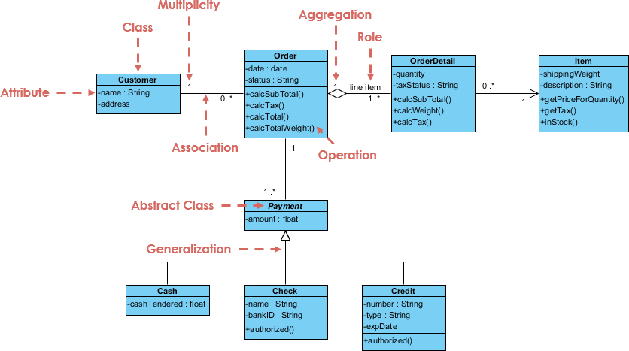
Class-based modeling [contd..]
Association
Example:
Online Shopping
ShoppingCart
-noOfItems : int
Notes:
Entries: Customer, Order, Item, Payment, Shopping Cart

Slide 13
Scenario-based modeling
Represents the system from the user’s point of view
By focusing on real-world scenarios and user tasks, the methodology helps to ensure that the system meets the needs of its users and stakeholders.
E.g., Activity diagram

Slide 14
Scenario-based modeling [contd..]
Components of an activity flow diagram:
Start
Activity Parallel Activity
yes Condition
End
No
Activity name

Slide 15
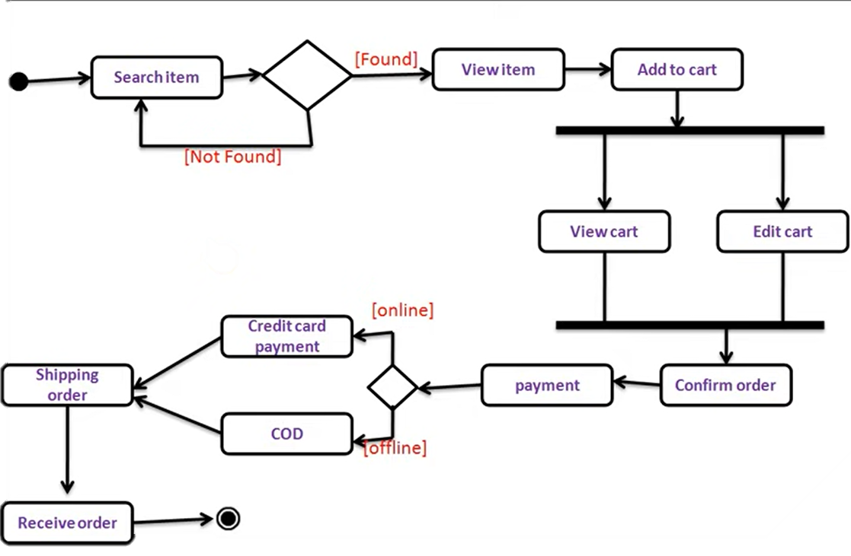
Scenario-based modeling [contd..]
Example:

Slide 16
Behavioral modeling
Depicts the states of classes and the impact of events on these states.
Involves creating models that describe how the system should behave in different scenarios or use cases.
E.g., Sequence Diagram

Slide 17
Behavioral modeling [contd..]
Components of a sequence diagram
object actor
activation box lifeline

Slide 18
Behavioral modeling [contd..]
Components of a sequence diagram
Synchronous message
Asynchronous message
Reply message symbol

Slide 19
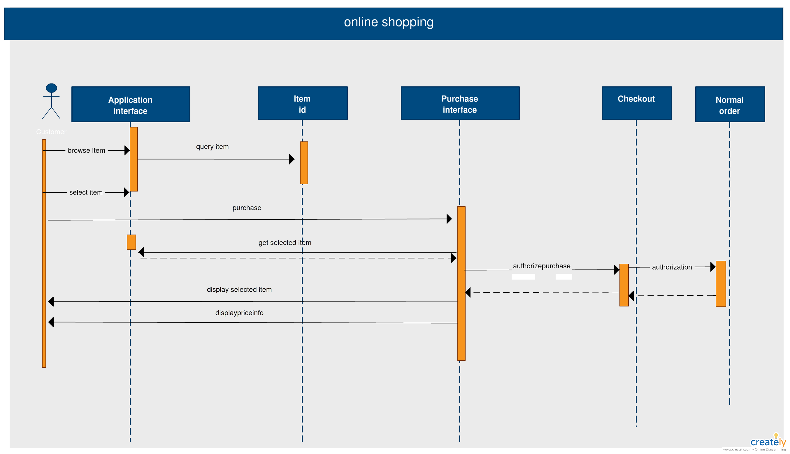
Behavioral modeling [contd..]
Components of a sequence diagram

Slide 20
Flow-oriented Modeling
Provides an indication of how data objects are transformed by a set of processing information.
The software system is decomposed into smaller subsystems or modules that can be independently analyzed and designed.
E.g., Component diagram

Slide 21
Flow-oriented Modeling [contd..]
Component Name
Component
Provided Interface
Required Interface
port

Slide 22
Flow-oriented Modeling [contd..]
Required Interface
Component
Other Component
Provided Interface

Slide 23
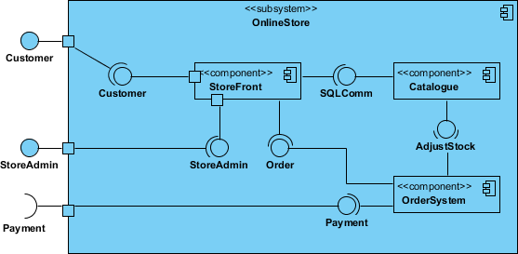
Flow-oriented Modeling [contd..]
Repository
Request Item

Slide 24
Quiz
A library has a catalog of books, which are available to borrow by its members. The system allows users to search for books, borrow books, return books, and manage their account information. Every member has an account in the library, which is verified by the librarian every time they borrow a book. The member can borrow the book through their account but can borrow 4 books (maximum) at a time.
Draw class diagram, sequence diagram, and activity diagram of the given scenario

